Slide 1


PROJECT COMMUNICATIONS MANAGEMENT

Slide 2
What is IT project communications management?
A subset of project management that includes the processes required to ensure timely and appropriate generation, collection, distribution, storage, and ultimate disposition of project information.

Slide 3
Importance of Good Communications
The greatest threat to many projects is a failure to communicate
Our culture does not portray IT professionals as being good communicators
Research shows that IT professionals must be able to communicate effectively to succeed in their positions
Strong verbal skills are a key factor in career advancement for IT professionals

Slide 4
Project Communications Management Processes
Identifying stakeholders: identifying everyone involved in or affected by the project and determining the best ways to manage relationships with them
Communications planning: determining the information and communication needs of the stakeholders
Information distribution: making needed information available in a timely manner
Performance reporting: collecting and disseminating performance information
Administrative closure: generating, gathering, and disseminating information to formalize phase or project completion

Slide 5
Identifying Stakeholders
Recall that the ultimate goal of project management is to meet or exceed stakeholder needs and expectations from a project, so you must first identify who your particular project stakeholders are
Two key outputs of this process include:
  Stakeholder register: a public document that includes details related to the identified project stakeholders (see Table 3-4 for an example)
  Stakeholder management strategy: an approach to help increase the support of stakeholders throughout the project; often includes sensitive information

Slide 6
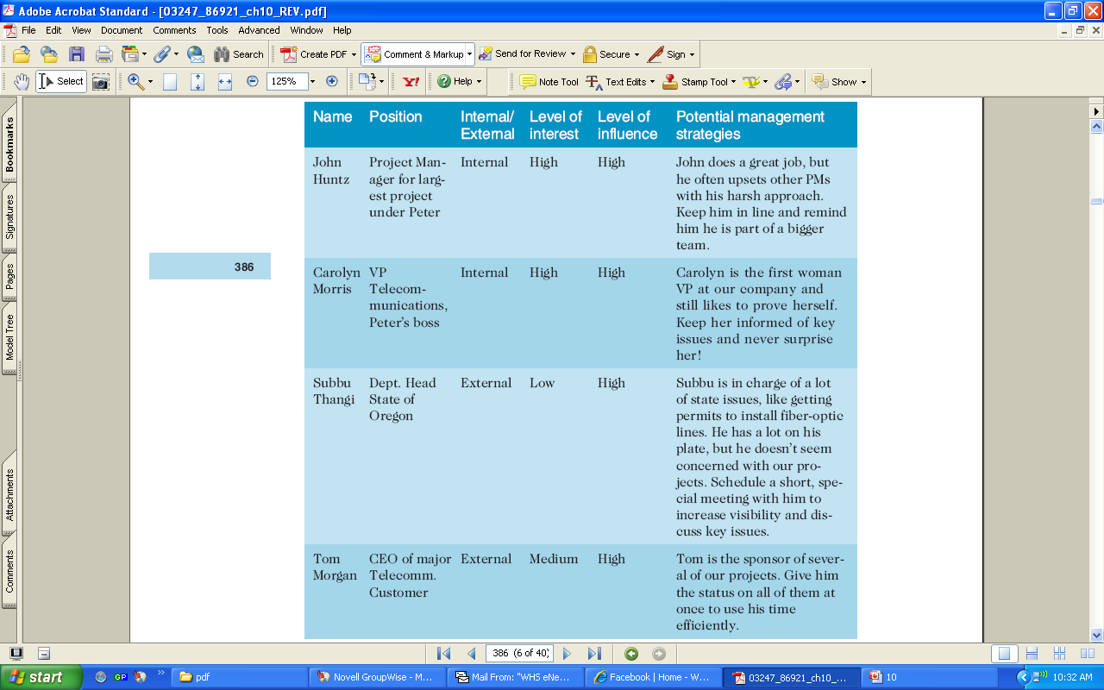
Stakeholder Management Strategy

Slide 7
Communications Planning
Every project should include some type of communications management plan, a document that guides project communications
Creating a stakeholder analysis for project communications also aids in communications planning

Slide 8
Communications Management Plan Contents
A description of a collection and filing structure for gathering and storing various types of information
A distribution structure describing what information goes to whom, when, and how
A format for communicating key project information
A project schedule for producing the information

Slide 9
…continued
Access methods for obtaining the information
A method for updating the communications management plans as the project progresses and develops
A stakeholder communications analysis

Slide 10
Sample Stakeholder Analysis for Project Communications

Slide 11
Information Distribution
Getting the right information to the right people at the right time and in a useful format is just as important as developing the information in the first place
Important considerations include
  using technology to enhance information distribution
  formal and informal methods for distributing information

Slide 12
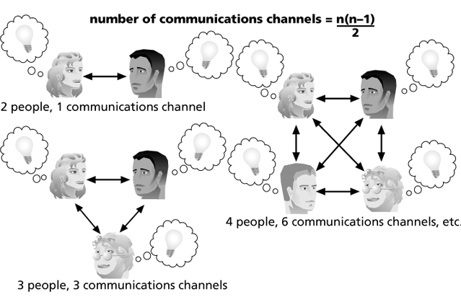
THE IMPACT OF THE NUMBER OF PEOPLE ON COMMUNICATIONS CHANNELS

Slide 13
Distributing Information in an Effective and Timely Manner
Don’t bury crucial information
Don’t be afraid to report bad information
Oral communication via meetings and informal talks helps bring important information—good and bad—out into the open

Slide 14
Performance Reporting
Performance reporting keeps stakeholders informed about how resources are being used to achieve project objectives.
For example
  Status reports describe where the project stands at a specific point in time
  Progress reports describe what the project team has accomplished during a certain period of time
  Project forecasting predicts future project status and progress based on past information and trends
  Status review meetings often include performance reporting

Slide 15
Administrative Closure
It is concerned with generating, gathering, and disseminating information to formalize phase or project completion
A project or phase of a project requires closure
Administrative closure produces
  project archives
  formal acceptance
  lessons learned

Slide 16
Conflict Handling Modes, in Preference Order
Confrontation or problem-solving: directly face a conflict
Compromise: use a give-and-take approach
Smoothing: de-emphasize areas of differences and emphasize areas of agreement
Forcing: the win-lose approach
Withdrawal: retreat or withdraw from an actual or potential disagreement

Slide 17
Conflict Can Be Good
Conflict often produces important results, such as new ideas, better alternatives, and motivation to work harder and more collaboratively
Groupthink can develop if there are no conflicting viewpoints
Research by Karen Jehn suggests that task-related conflict often improves team performance, but emotional conflict often depresses team performance

Slide 18
Running Effective Meetings
Define the purpose and intended outcome of the meeting
Determine who should attend the meeting
Provide an agenda to participants before the meeting
Prepare handouts, visual aids, and make logistical arrangements ahead of time
Run the meeting professionally
Build relationships

Slide 19
DEVELOPING A COMMUNICATIONS INFRASTRUCTURE
A communications infrastructure is a set of tools, techniques, and principles that provide a foundation for the effective transfer of information
  Tools include e-mail, project management software, groupware, fax machines, telephones, teleconferencing systems, document management systems, and word processors
  Techniques include reporting guidelines and templates, meeting ground rules and procedures, decision-making processes, problem-solving approaches, and conflict resolution and negotiation techniques
  Principles include using open dialog and an agreed upon work ethics

Slide 20
Using E-Mail Effectively
Make sure that e-mail is an appropriate medium for what you want to communicate
Be sure to send the e-mail to the right people
Use meaningful subjects
Limit the content to one main subject, and be as clear and concise as possible
Limit the number and size of attachments
Delete e-mail you don’t need, and don’t open it if you question the source
Make sure your anti-virus software is up to date
Respond to and file e-mails quickly
Learn how to use important features

Slide 21
Using Templates for Project Communications
Many technical people are afraid to ask for help
Providing examples and templates for project communications saves time and money
Organizations can develop their own templates, use some provided by outside organizations, or use samples from textbooks
Recall that research shows that companies that excel in project management make effective use of templates

Slide 22
Using Software to Assist in Project Communications
There are many software tools to aid in project communications
Today more than 37 percent of people telecommute or work remotely at least part-time
Project management software includes new capabilities to enhance virtual communications

Slide 23
MANY THANKS

